Slide 1

Smart neighborhood system for shutters management
Baraldi Francesco, Pagliani Matteo

Slide 2
Picture of our prototype

Slide 3
Introduction
Too lazy to close the shutters in case of a thunderstorm?
Do you often forget to close the shutters before falling asleep?
Or do your flowers need sunlight when you are on holiday away from home?
→ This system is the answer for you! Our product automatically open or close the shutters of your house depending on weather conditions. Its scalability allows it to be used not only by you, but also by your neighbours, aiming to control the shutters of several houses simultaneously.

Slide 4
Introduction (1)
You don’t have to worry about anything, the system takes care of your house for you:
You will be notified directly on your smartphone when a decision is taken by the system, and you can feed back if you liked that decision or not, giving us the possibility to improve based on your habits! So that the system learn how to perfectly fit your needs
When you are away, you can always control the shutters remotely via web
Obviously, you can control the shutters manually thanks to specific buttons installed in your house
The system takes into account your neighbours action to make better decisions on your own windows

Slide 5
Introduction (2)
The kit is easy to install. It’s composed by:
A microcontroller, an actuator and a button for each of the windows you want to control
Some sensors (photoresistor, wind speed sensor) and a control unit for the whole neighborhood, which will be installed in a strategic position close to the houses to be managed
And finally you shall install the Telegram application on your smartphone

Slide 6
Why chosing us?
Easy setup
Not invasive
Fully autonomous
Scalable

Slide 7
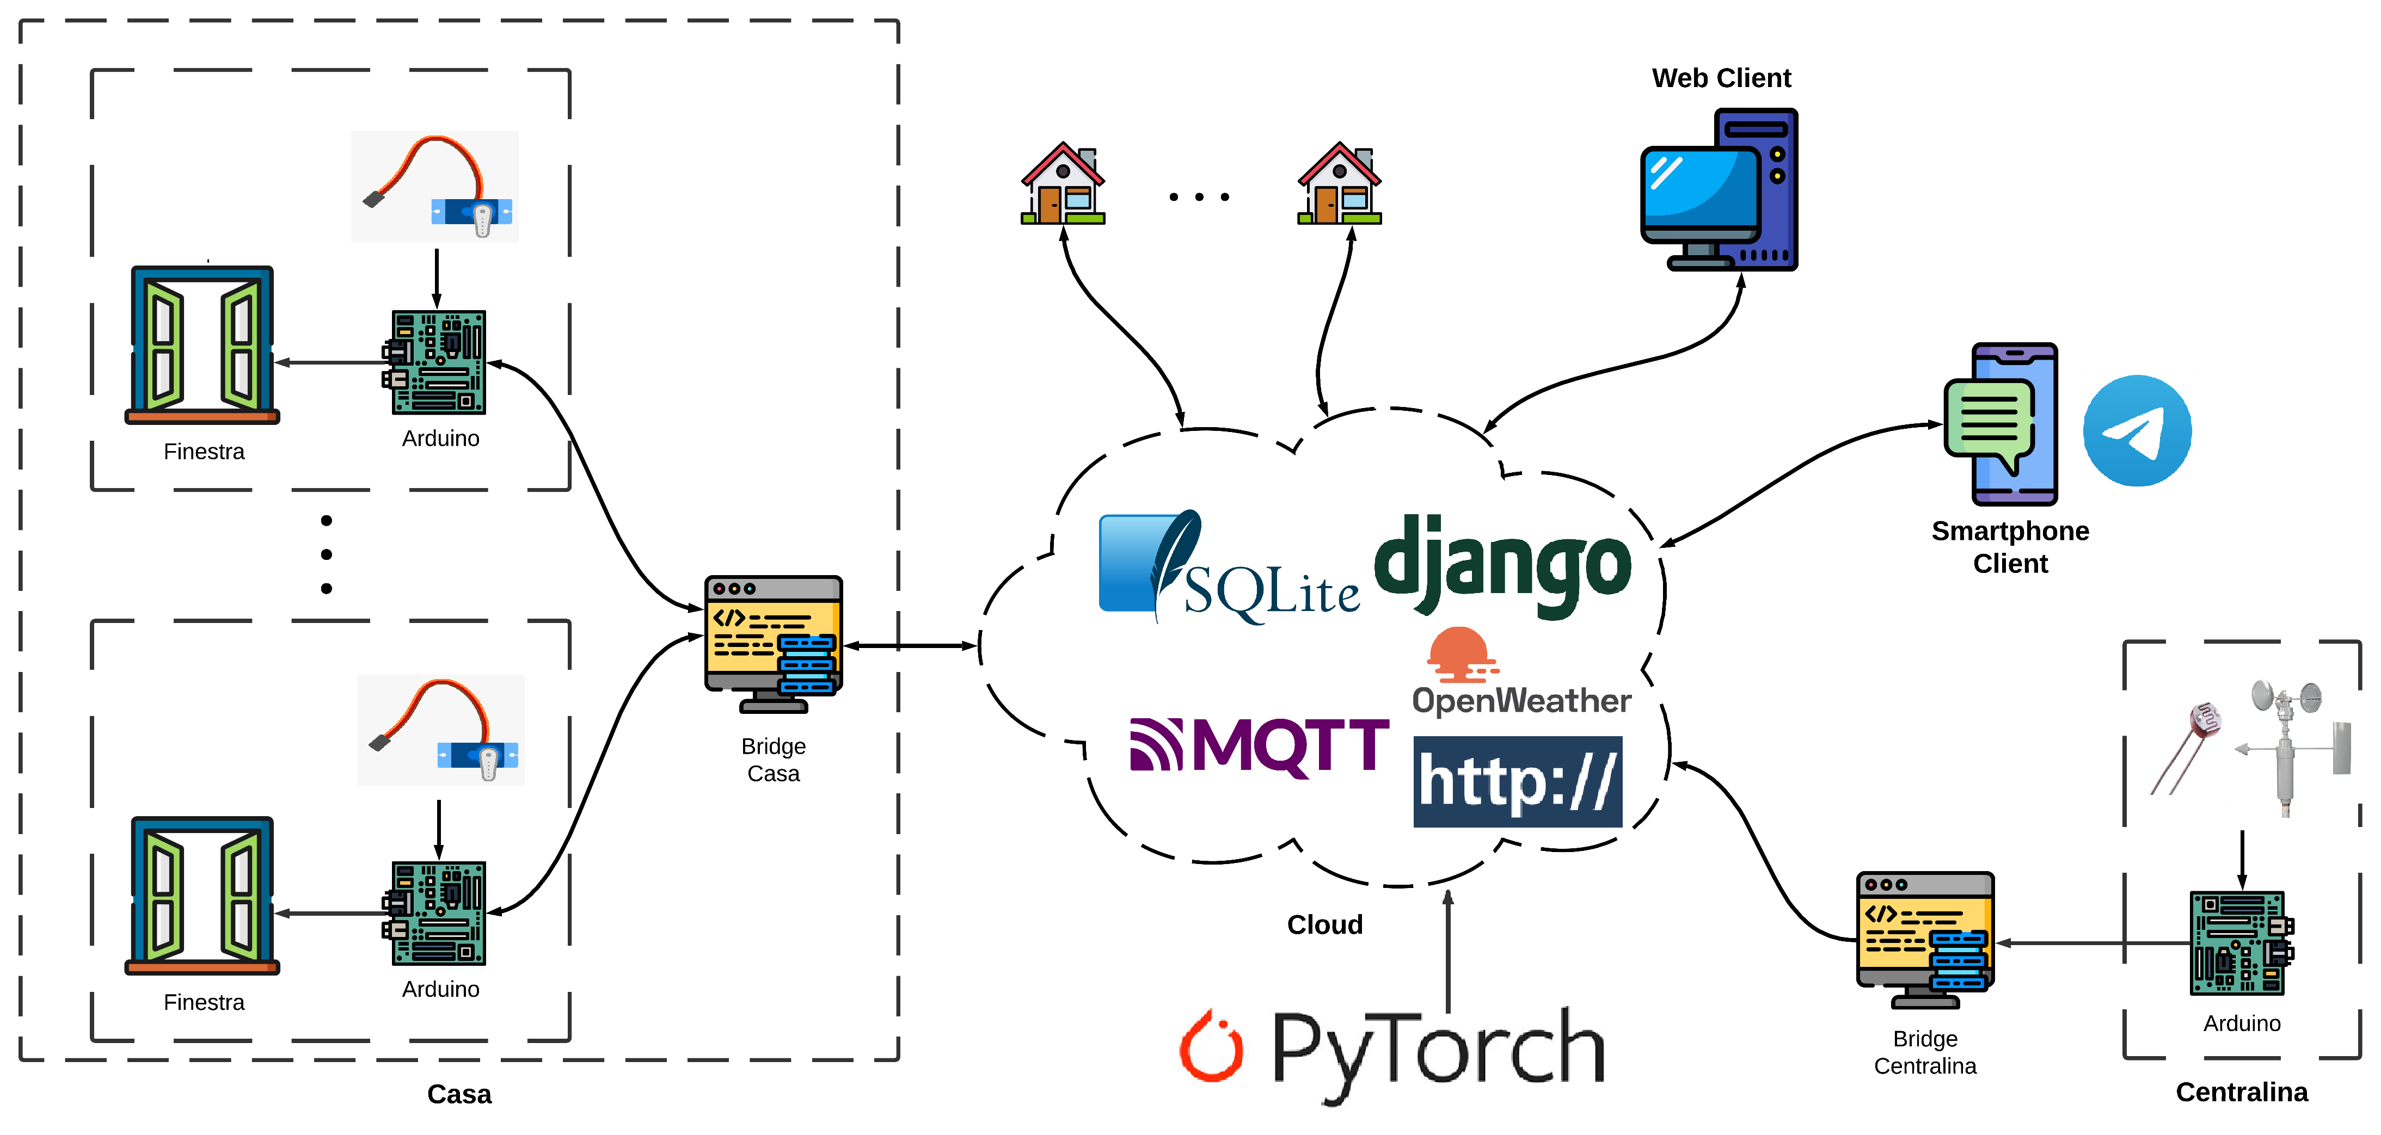
Architecture: real model

Slide 8
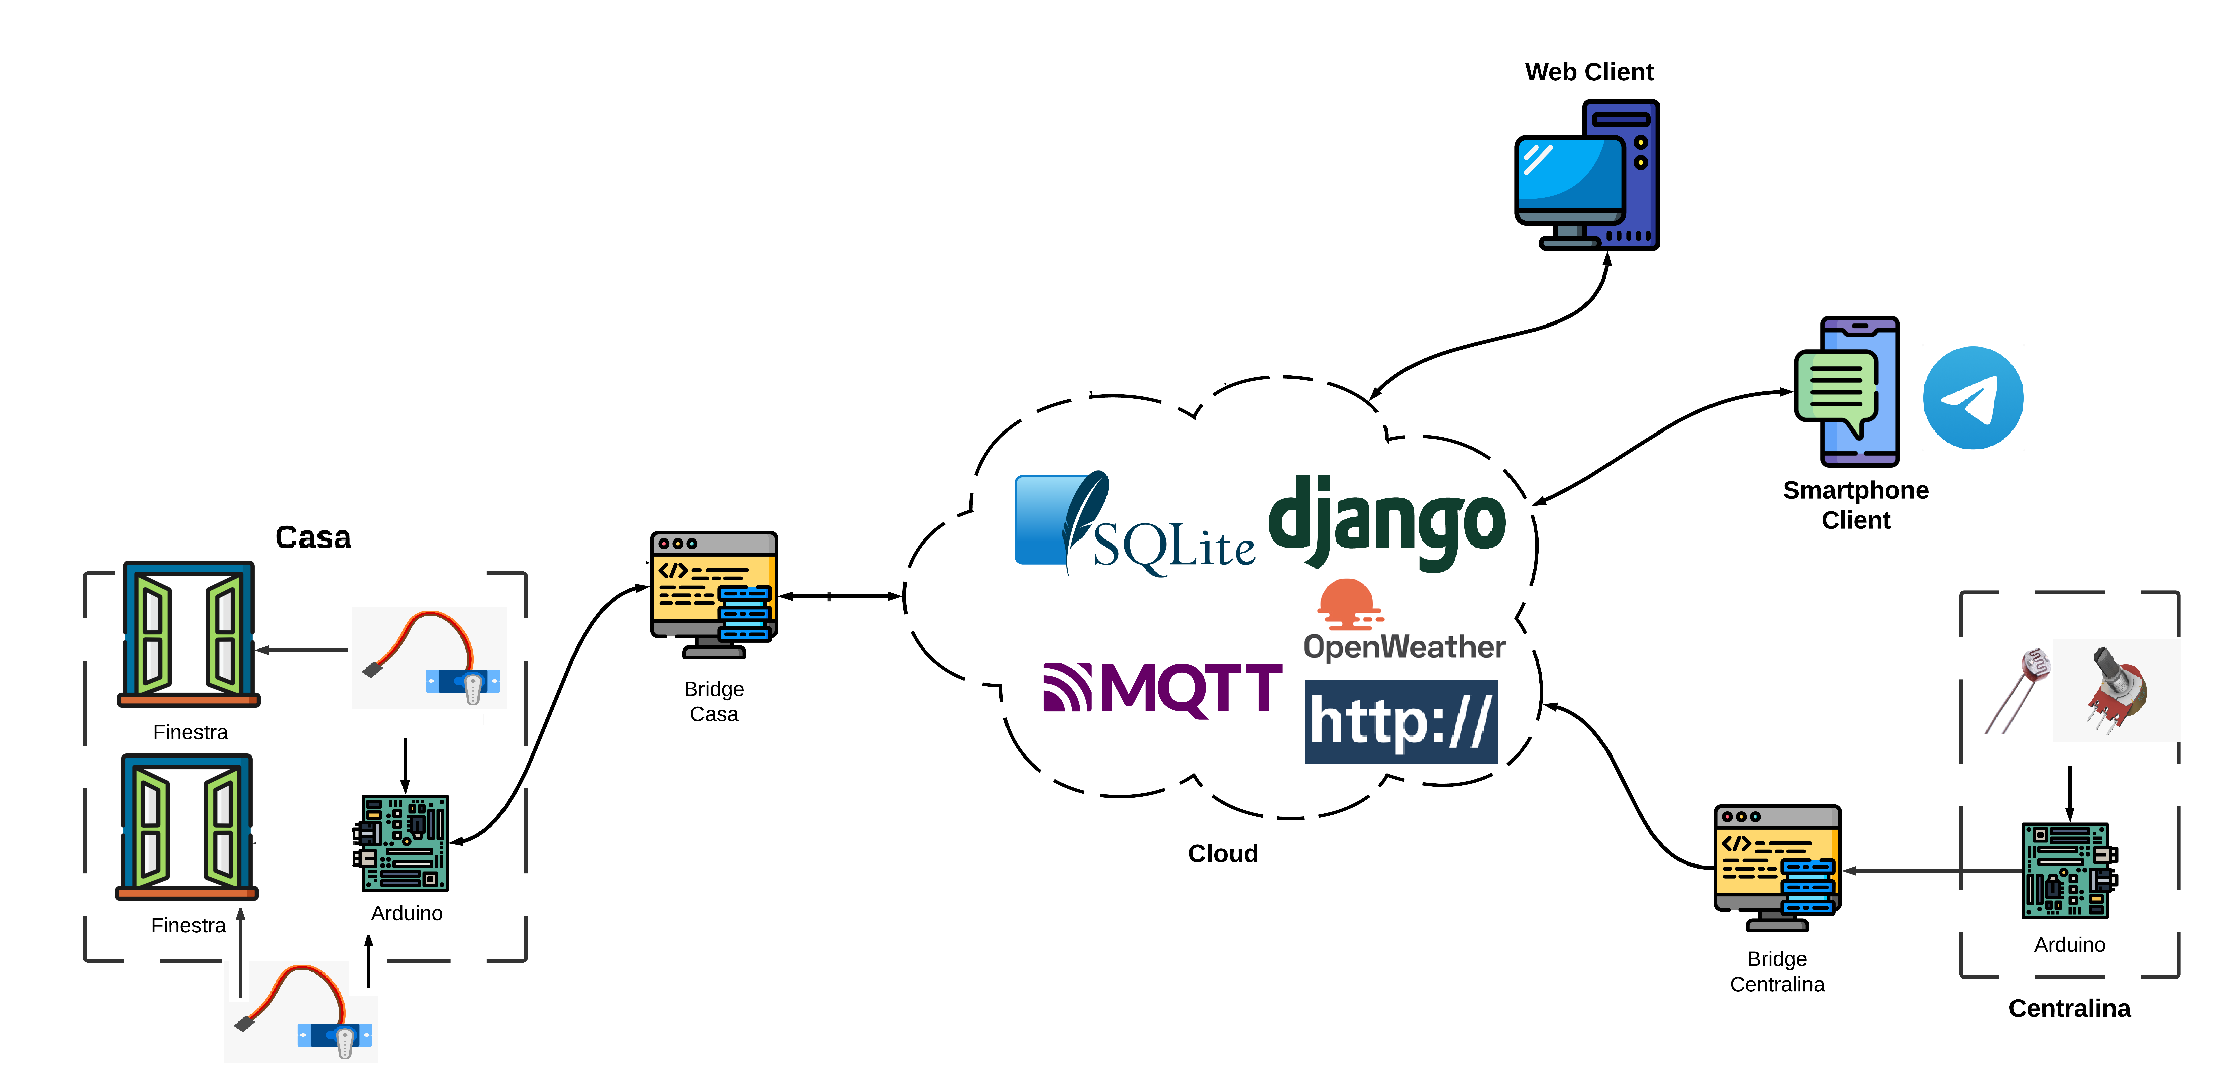
Architecture: prototype

Slide 9
Real model vs prototype
Real Model | Prototype
1 Raspberry Pi for each window ? | 1 Arduino UNO Rev.3 for two windows
Bridge ? | Laptop as bridge
Prettier buttons | Push buttons
1 custom actuator for each window | 1 servomotor for each window (Hitec and TowerPro)
Wind speed sensor | 1 potentiometer as wind speed sensor
Proper web app frontend for improved UE | Simple web app
Reinforcement Learning approach | Neighbours “control” in case of uncertainty

Slide 10
Prototype specifications
Microcontrollers
Sensors and actuators
FSM for buttons
Servo logic
Communication Protocols (Serial, HTTP e MQTT) and messages structure
Bridges
Engine
Web App
Telegram Bot
DB Sqlite structure
Neighbours dependency in case of uncertainty

Slide 11
Extra: Reinforcement Learning predictions

Slide 12
Video DEMO?

